Slide 1
Project First Evaluation
Project Name: I2c Based Accelerometer Device Driver using Beaglebone Black
Group Members:
1.Chetan Surlaskar
2.Tejas Kale
3.Gauri Khapare
4.Rutuja Gaikwad
Mentor Name:

Slide 2
Project Overview
Title: I2C-based Accelerometer Device Driver on BeagleBone Black Goal: To develop and test a Linux kernel device driver for an accelerometer sensor interfaced via I2C on the
BeagleBone Black.
Hardware Used:
BeagleBone Black (BBB)
I2C Accelerometer (MPU6050)
Connecting Wires
Power Supply
Software Used:
Debian/Linux on BBB
Kernel Source / Cross Compiler
Device Tree Overlays
Vim/GCC/Make
I2C tools (i2cdetect, i2cget, etc.)

Slide 3
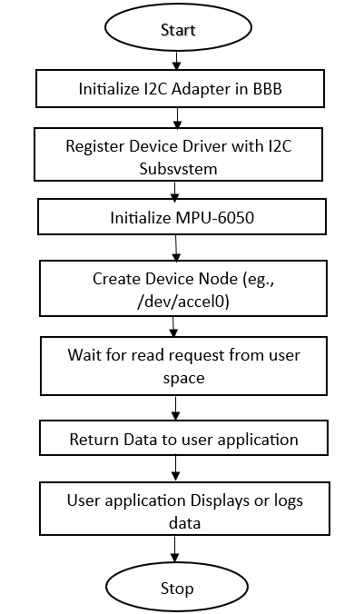
Flow Chart

Slide 4
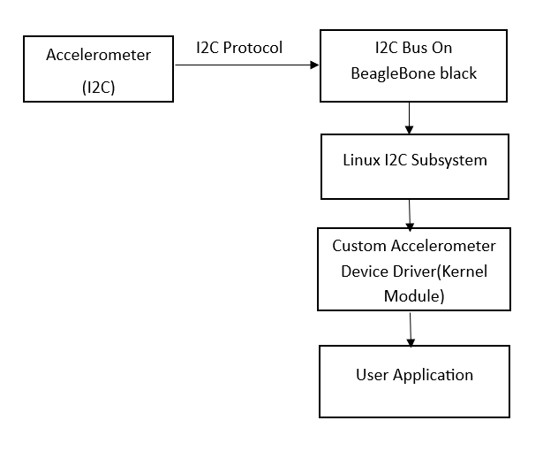
Block Diagram

Slide 5
Reference Papers/Documents
Linux I2C Subsystem Documentation → https://www.kernel.org/doc/html/latest/i2c/index.html
BeagleBone Black System Reference Manual
I2C Accelerometer Datasheet (e.g., MPU6050 or ADXL345)
Linux Device Drivers (3rd Edition) by Jonathan Corbet

